Slide 1
OR/SYST 568
APPLIED PREDICTIVE ANALYSIS
Fire Risk Forecasting using Predictive Modelling and Data Analytics
Fairfax County Fire Prevent Service

Slide 2
Objective
The Fairfax County Fire and Rescue Department is combination career and volunteer organization providing fire suppression, emergency medical, technical rescue, hazardous materials, water rescue, life safety education, fire prevention and arson investigation services
The main objective of this project is to build a model to predict the fire risk and prioritize fire inspections for the Fairfax County area.
The model is built on the dataset formed by joining the properties and information from previous fire incidents, fire inspections ,relevant Fairfax county property and tax information

Slide 3



dATASET
Data Source: Fairfax County Fire Prevent Service
https://www.fairfaxcounty.gov/fire-ems/
The main data for building the model is of two sections
1. Fire Incidents
Contains all information about the fire incidents that happened in the Fairfax County
2. Fire Inspections
Contains all information about the fire inspections that has been carried out in the Fairfax County

Slide 4
FIRE INCIDENTS
The fire incidents data has all the fire incidents happened in Fairfax County area from 2016 to 2021.We have approximately 13000 fire incidents reported in the area.
There were 81 features in the dataset, After careful analysis and consideration the number of features were reduced to 20.
The features used in the final model are described in the table.
Attribute Incident_happ is the final target variable indicates the occurrence of fire incidents when the datasets are joined is added and has value 1. For the property information which does not have fire incidents information will have Incident_Happ 0.
Field | Description
FinalIncidentType | CAD event type at the time call was closed
DispatchPriority | Dispatch priority level; AD event type at the t
AlarmLevel | Alarm level;
StreetNumber | Dispatched street address number
StreetPrefix | dispatched street address prefix
StreetName | dispatched street address name
StreetType | dispatched street address type
StreetSuffix | dispatched street address suffix
Apartment | dispatched street address apartment number
City | dispatched street address city
ZipCode | dispatched street address zip code
StreetAddress | concatenated dispatched street address
CommonPlaceName | CAD-assigned common place name
xCoordinate | x coordinate of geo-verified dispatched address
yCoordinate | y coordinate of ge-verified dispatched address
ADCMapGrid | ADC map grid number
FireBox | CAD-assigned fire box of dispatched address
NFIRSTypeCode | NFIRS report incident code
CalendarYear | Calendar year during which incident occurred.
Incident_Happ | =1 . Target variable the model will be predicting this attribute

Slide 5
FIRE INSPECTIONS
Field | Description
ApplicationType | The abbreviated name of the Application/Permit template used
ApplicationStatus | Defines the status of the application if it has been canceled. If the STAT is empty, then the application is good to go. O-Open, C-Closed, V-Void, S-Stop Work
StatusName | Text description of StatusId.
AddressKey | Key to an address. This is a system generated, non-display, sequential number.
X | The longitude coordinate for the geocoded inspection location in decimal degrees (WGS84 coordinate system).
Y | The latitude coordinate for the geocoded inspection location in decimal degrees (WGS84 coordinate system).
Miles_To_Nearest_Station | Straight-line Euclidean distance between the inspection location and the nearest Fire Station (in miles).
Miles_To_Nearest_Office | Straight-line Euclidean distance between the inspection location and the nearest Fire Prevention Office (in miles).
Station | The number of the nearest station.
Company | The number of the company.
Jurisdiction | The party responsible for the inspection or permit processing (e.g., Fairfax County, City of Fairfax).
Office | The nearest fire prevention office to the inspection location.
The fire sections data has the details of the fire inspections happened in Fairfax County area from 2001 to 2021.We have approximately 444K reported fire inspections happened over the years.
Most of the inspections are happening over at the location year after year and the inspections are rated Pass or Fail
There were 24 features in the dataset, After careful analysis and consideration the number of features were reduced to 12.
The attributes X latitude and Y latitude are used to join the dataset with Fire Incidents dataset.

Slide 6
ADDRESS POINTS
Address points dataset includes full address and parcel ID number for Fairfax County.
This data contains the point features representing the address points, with attributes that include full address and parcel ID number for Fairfax County.
This is the main dataset for Joining the Fairfax country Fire Inspection/Incidents dataset with other GIS and Property related dataset
The Address Points dataset joins the Fire Inspection/Incident dataset by X and Y Latitudes and Includes Parcel Identifier (PIN) for those available addresses. This PIN can be used to join with other Property datasets
Field | Description
X | X latitude
Y | Y latitude
ADD_ADDRESS_KEY | Address Key
PARCEL_PIN | Parcel Identifier

Slide 7
Tax Administration's Real Estate - Dwelling Data
Field | Description
PARID | Parcel Identifier
STYLE_DESC | Style
Remodified | Has attribute Yes/No for Remodelled.Derived column from YRREMOD(Year house remodeled)
RMBED | Bedroom count
FIXBATH | Full bath count
FIXHALF | Half bath count
RECROMAREA | Basement Rec room size (sq.ft)
WBFP_PF | Number of fireplaces
BSMTCAR | Basement garage (# of cars)
SFLA | Above grade living area total sq ft
BSMT_DESC | Basement description
CDU_DESC | Physical condition description
EXTWALL_DESC | Exterior wall materia
HEAT_DESC | Heating description
USER13_DESC | Roof type description
Total_No_Years | Derived value; Current Yr minus the Year Built(YRBLT)
The Tax Dwelling data dataset contains information about the external structure on the parcel including year built, number of bedrooms and bathrooms and style for properties within Fairfax County. There is a one to many relationship to the parcel dataset
Out of the 22 features in the dataset, We are considering 16 features in the model which are described in the table.
The Tax Administration dwelling dataset is joined to Address Points dataset through Parcel Identifier (PIN).

Slide 8
TAX ADMINISTRATION 's Real Estate - Land Data
Tax Administration Real Estate Land Data contains the information about the land including land sizes (square feet & acres) and land property type for properties within Fairfax County. There is a one-to-many relationship to the parcel data.
There were 7 features in the dataset, After removing the zero variance attribute the number of attributes were 6.
The code_desc is an important attribute which identifies what type of property it is – Commercial, Residential, Agricultural land etc
The Tax Administration Land dataset is joined to Address Points dataset through Parcel Identifier (PIN).
Field | Description
PARID | Parcel identifier
LLINE | Line number
SF | Land size in square feet
ACRES | Land size in acres
UNITS | Number of units
CODE_DESC | Land description

Slide 9
Preprocessing - Cleaning
There missing values are first imputed to their median values. Those records that cannot be imputed and are still having Na values are dropped.
The attributes having Null values for more than 25% of the data are dropped.
All the unique identifiers are removed.
The attributes that does not have any variance are identified using nearZeroVar and are removed.
Box-cox transformation, centering and scaling was performed to numeric predictors present in the data.

Slide 10
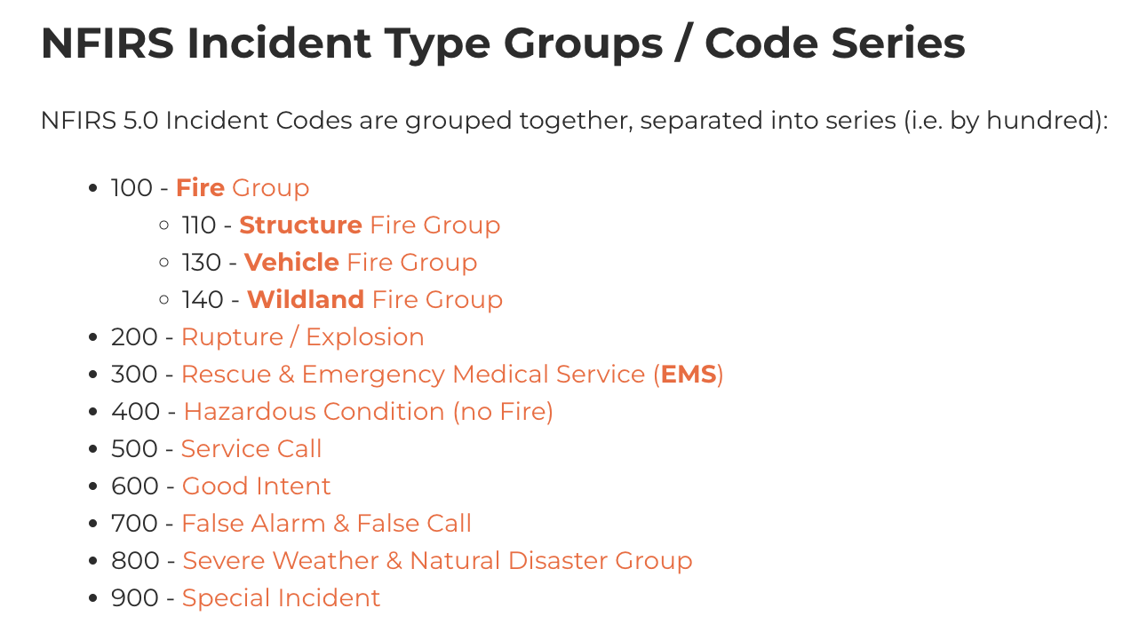
Preprocessing - FILTering
The NFIRSTypeCode column from Fire incidents data was filtered to retain only those codes in which actual fire has occurred.
The Application type "TRANSPORT VEHICLE FOR BLASTING" was removed from the Fire inspections data as it was irrelevant to the model.

Slide 11
Preprocessing – Joining Datasets
After cleaning the data, the datasets were joined based on the location and parcel IDs.
The location coordinates of Fire incidents data were in Virginia State Plane Coordinate system(North Zone) whereas the location in Fire inspections data was present in longitude and latitude format of WGS84 coordinate system.
The coordinates in Virginia State Plane coordinate system were transformed to WGS84 coordinate system using the spTransform() method in rgdal library.
The fire incidents data was transformed into a binary variable and left joined with the fire inspections and other data to get the response variable.

Slide 12
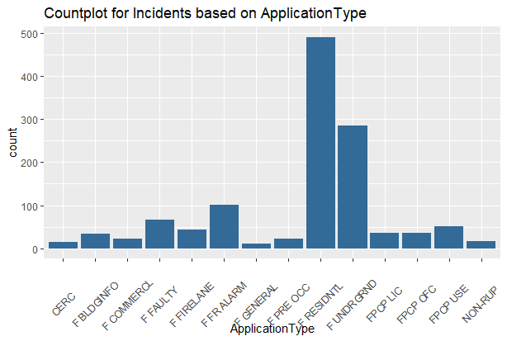
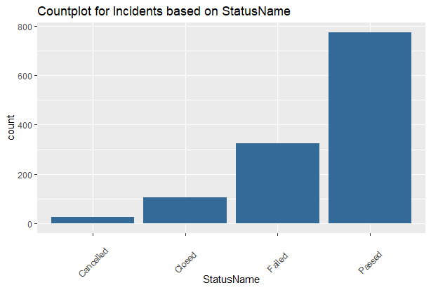
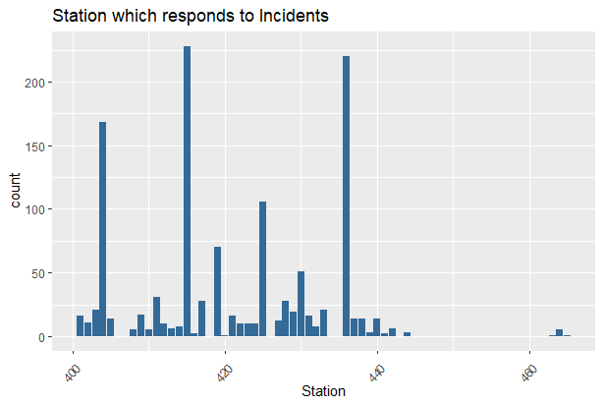
EXPLOratory data analysis
This graph is used to show the type of incidents that take place in Fairfax county
This graph is used analyze the station which responds to maximum no. Of incidents
Using the above graph, status of incidents are calculated.

Slide 13
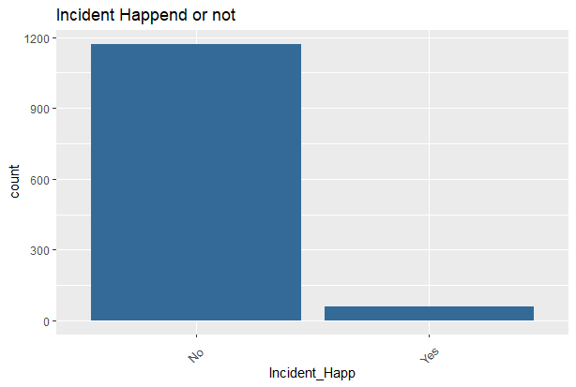
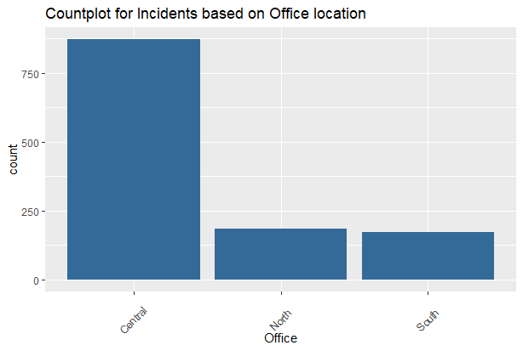
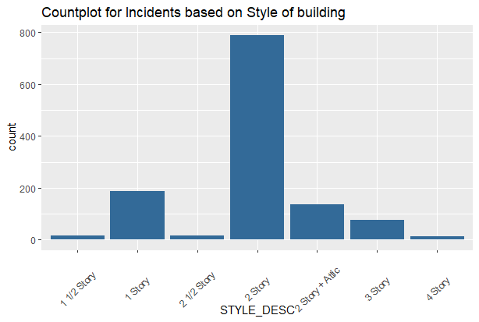
Change in number of incidents based on location
Number of incidents based on type of building

Slide 14
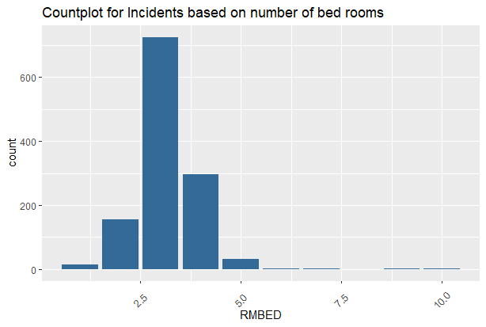
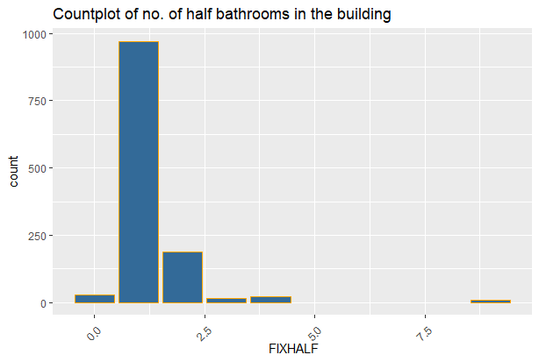
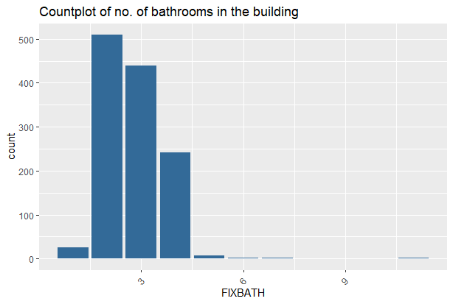
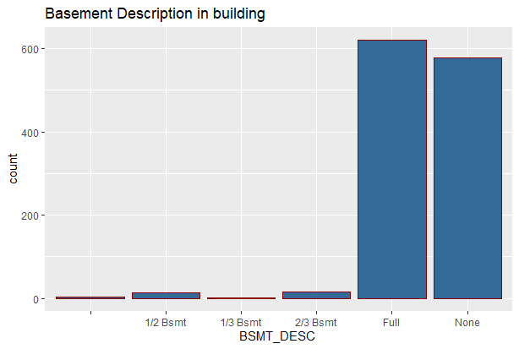
Building Description

Slide 15
Predictive modelling
Final dataset is developed by combining Fire Incidents , Fire Inspections, Tax-dwelling , Tax-Land, Address Points datasets.
Three models Logistic Regression, Random Forest and Stochastic Gradient Boosting were built to predict the incidence of fire.
Each model was created with 10-fold cross validation.
The response variable is the binary variable which conveys if the fire incident happened at that property.

Slide 16
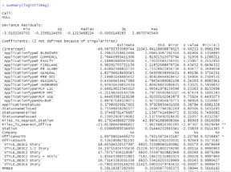
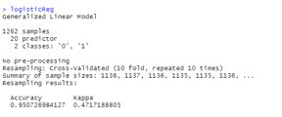
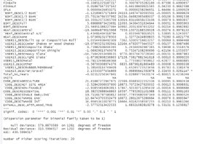
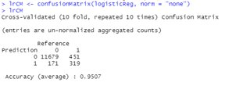
LOGISTIC REGRESSION
Logistic Regression – Model Building
Logistic Regression – Model Results
Logistic Regression – Confusion Matrix
Used cross validation with 10 folds for building the model

Slide 17
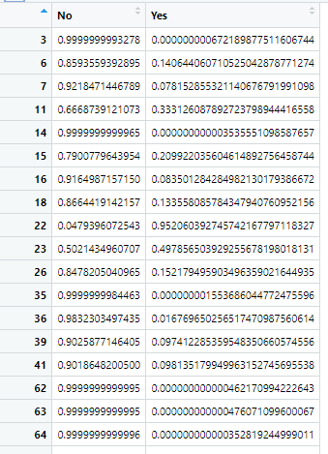
Calculating risk based on probability (logistic Regression)
Used the probability measure to
Measure risk of properties.
By looking at these probabilities of YES
Column we can say that by what % is a
Property at fire risk.
If the probability is 0.2099 then there is
Chance of 20.99% fire incident may happen.

Slide 18
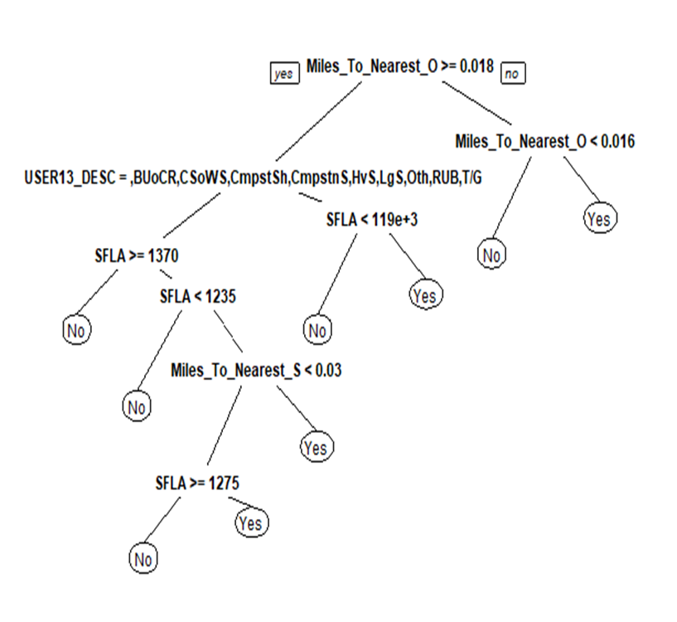
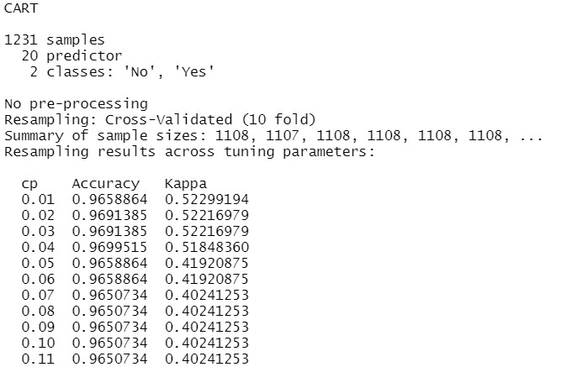
Decision Tree
Decision Tree
Model Building

Slide 19
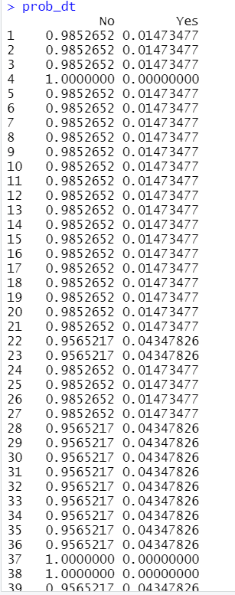
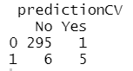
Decision Tree
Confusion Matrix
Probability prediction Using Decision Tree

Slide 20
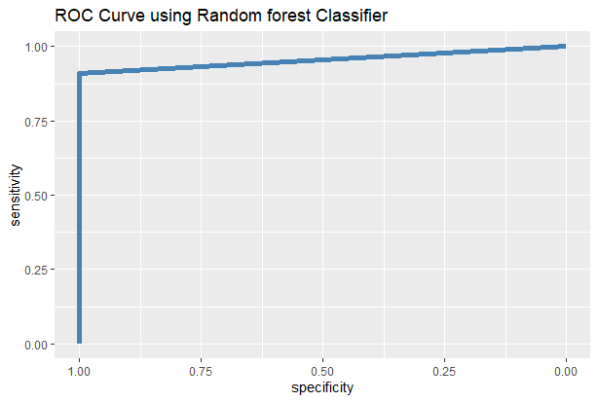
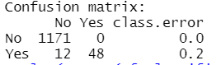
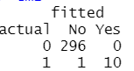
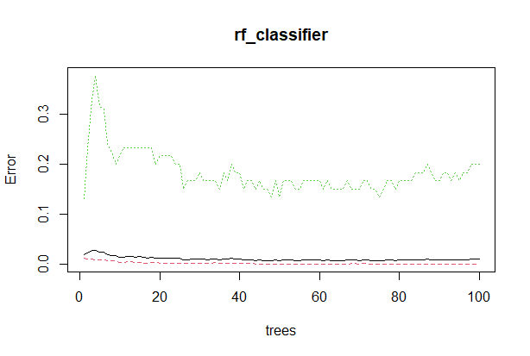
RANDOM FOREST CLASSIFIER
Random Forest Model – Confusion Matrix
Random Forest Model – ROC Curve
Random Forest Model

Slide 21
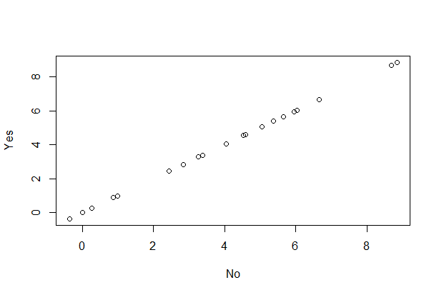
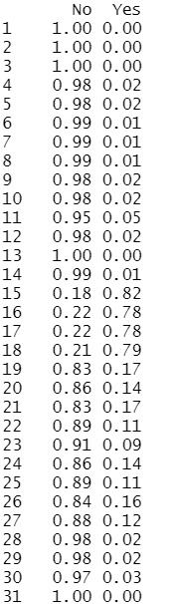
Variable Importance
Probability Calculation

Slide 22
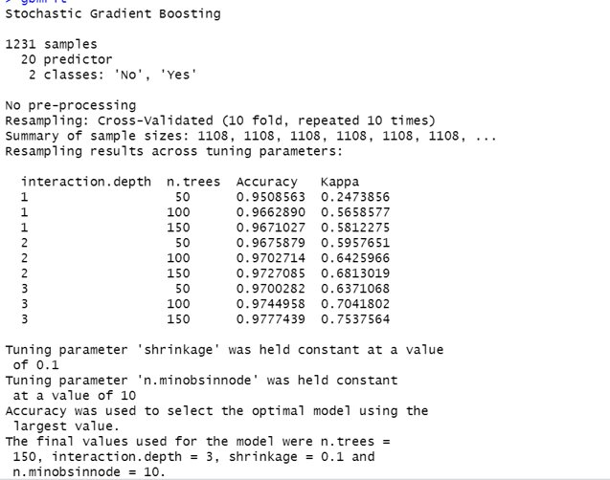
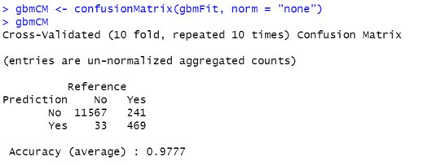
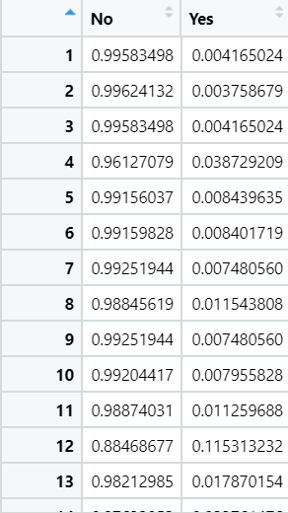
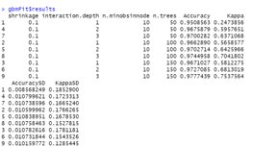
STOCHASTIC Gradient BOOSTING
Stochastic Gradient Boosting – Model Building
Stochastic Gradient Boosting – Confusion Matrix
Stochastic Gradient Boosting – Probability Matrix
Stochastic Gradient Boosting – Model Results

Slide 23
Thank you!

